Slide 1

Social Media Course: Mobile Web Content and Dev Professor: Mr. Llesh Miraj
Team 4:
Ravi Shankar, Dhwarakesh
Pereira, Dylan Patel,
Keya HarshadPatel,
Harsh Patel

Slide 2
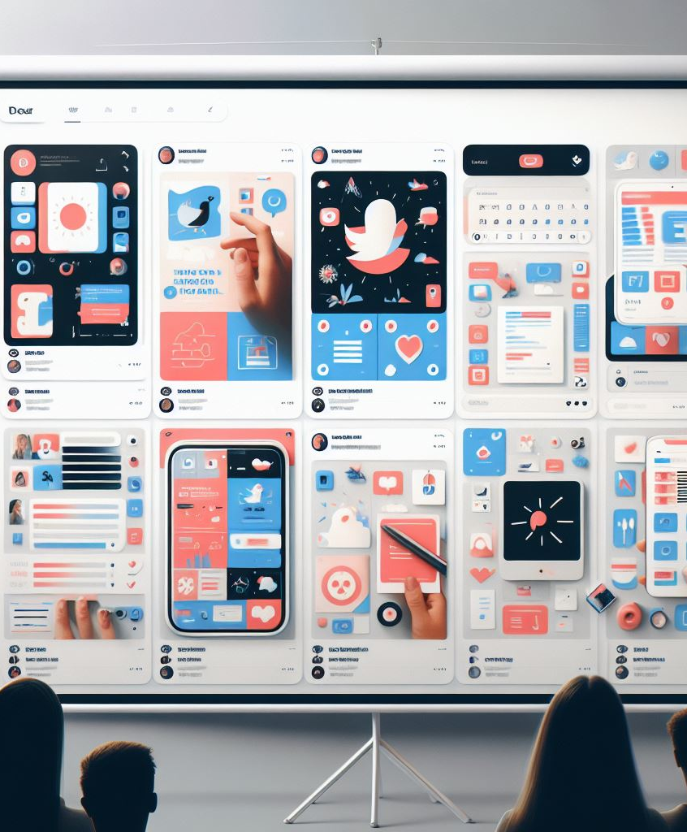
Project Objectives
Creating a user-friendly social media platform.
Implementing essential features for user interaction.
Ensuring security and privacy of user data.
Providing a seamless user experience across devices.

Slide 3
Features Overview
Separate user accounts with hashed passwords.
Like/unlike functionality for posts.
Commenting system with the ability to delete comments.
Post management options (editing and deletion).
Profile management including password change.
Authentication using access tokens.

Slide 4

User Authentication
User authentication is crucial for:
Protecting user accounts from unauthorized access.
Ensuring data security and privacy.
Authentication is done using access tokens generated during login.

Slide 5
Mobile Accessibility
Our Social Media App is designed to be accessible in mobile view, providing users with:
Seamless experience across devices.
Responsive design for optimal viewing on smartphones and tablets.
Mobile accessibility ensures that users can stay connected and engaged on the go, enhancing the overall user experience.

Slide 6

Live Demo

Slide 7
Thank you

